Slide 1


StreetSmart: Digital Informal Trade Permit System
Project Readiness & Deployment Review
Presenter: Bheki Mogola |
Role: Business Analyst
Date: December 10, 2025

Slide 2
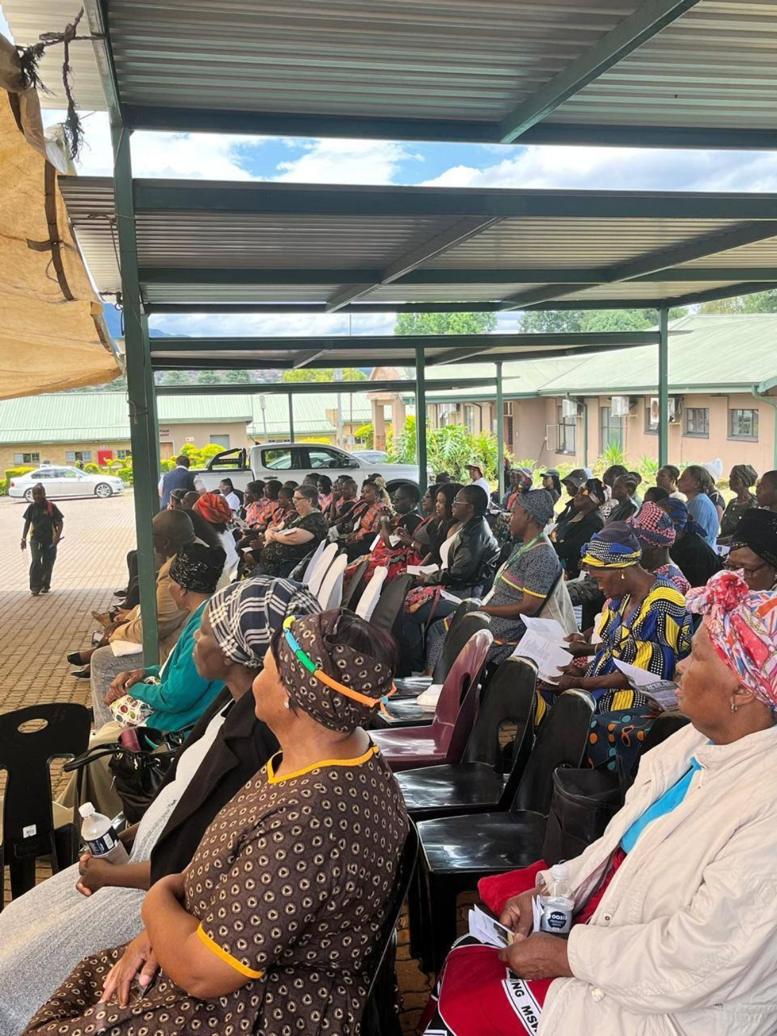
The Challenge: Inefficiency & Revenue Loss
Current State Crisis
Our municipality operates a manual, paper-based permitting system serving over 4,000 informal traders daily. This outdated process creates significant challenges for both vendors and municipal operations.
Vendor Pain Point: Average queue time of 3 hours per permit renewal, forcing traders to abandon their stalls and lose daily income.
Municipal Pain Point: High cash handling risks, limited compliance visibility, and substantial revenue leakage.
Critical Opportunity: Recover projected R8,000,000+ in lost fees annually through digital transformation.

Slide 3
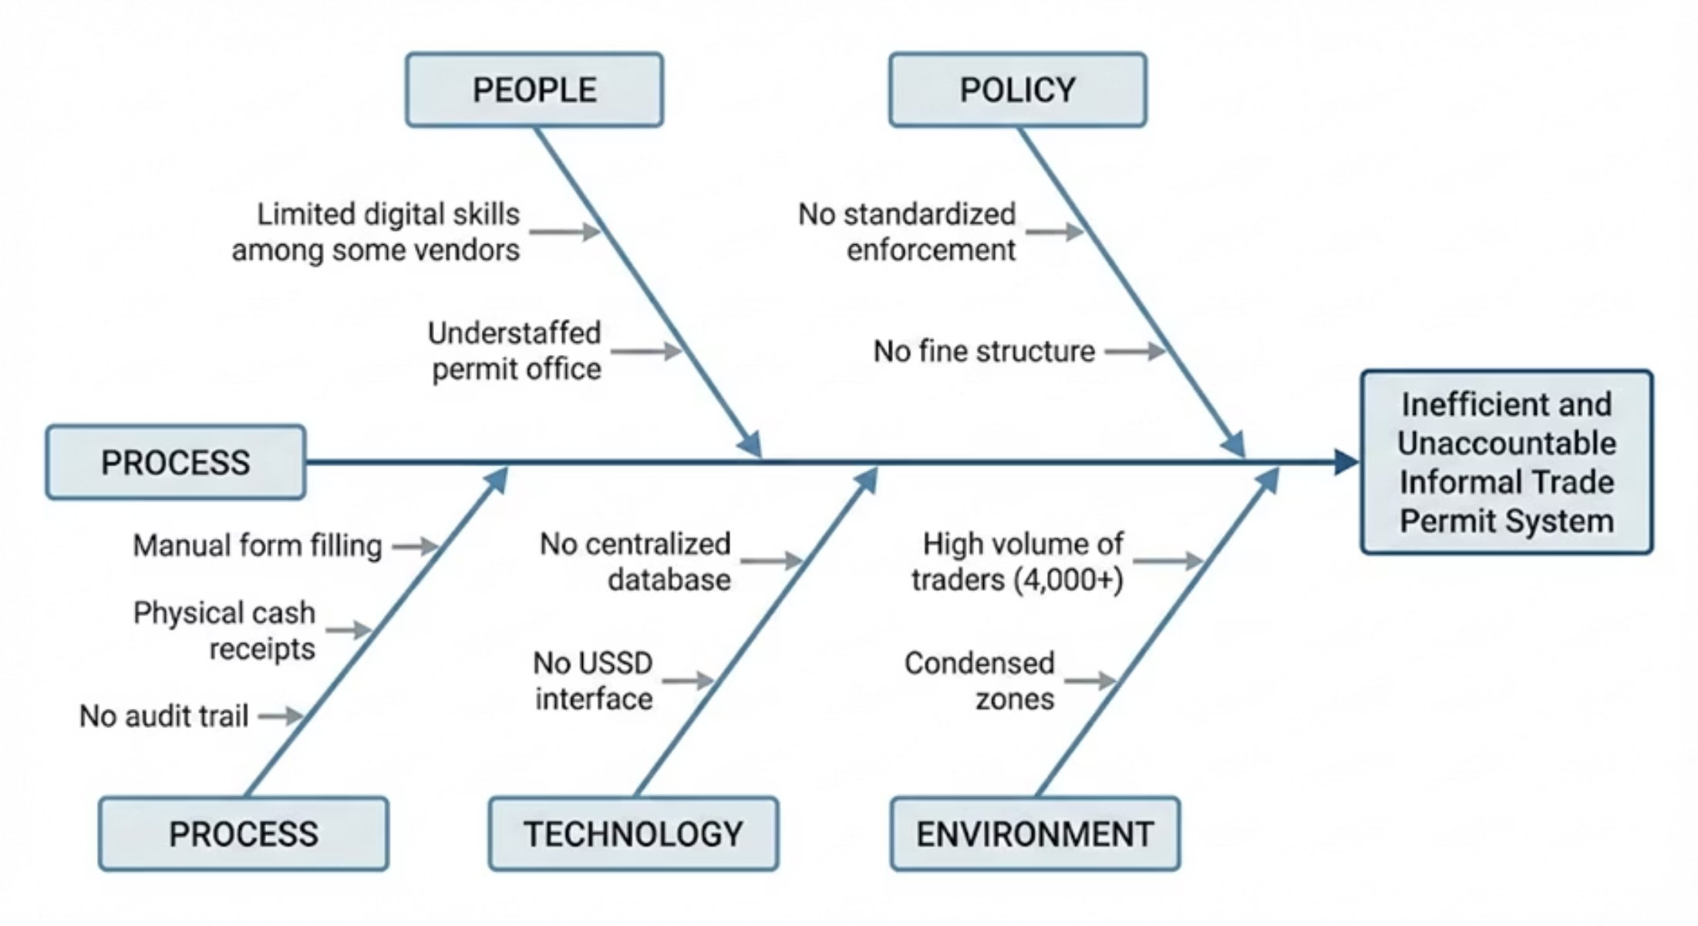

Why Is This Happening? Root Cause Analysis
Process Issues
Technology Gaps
Environmental Factors
Manual form filling and physical cash receipts create bottlenecks at every touchpoint. Paper-based workflows lack scalability and create unnecessary friction.
No centralized database exists to track permits. The absence of USSD interface prevents remote payments, forcing physical visits.
High volume of traders in condensed zones overwhelms current staffing levels, making manual verification impossible at scale.
Conclusion: A comprehensive digital transformation addressing Process, Technology, and People issues simultaneously is the only viable solution.

Slide 4

StreetSmart Solution Overview
Our solution delivers a multi-channel digital ecosystem designed to serve all stakeholders with their preferred technology. We've built accessibility and efficiency into every interaction point.
For Vendors: USSD Channel
For Vendors: Web Portal
Feature phone users dial *120*555# to register and pay instantly without internet access. SMS confirmations provide immediate proof of payment.
Smartphone users access a responsive web application for registration, payment, and permit management with enhanced features and document uploads.
For Inspectors: Mobile App
For Admin: Central Dashboard
Android app enables instant QR Code verification with sub-second scan times. Real-time status updates eliminate confrontation and improve compliance.
Comprehensive management console provides automated revenue reconciliation, zone analytics, and compliance monitoring in real-time.

Slide 5
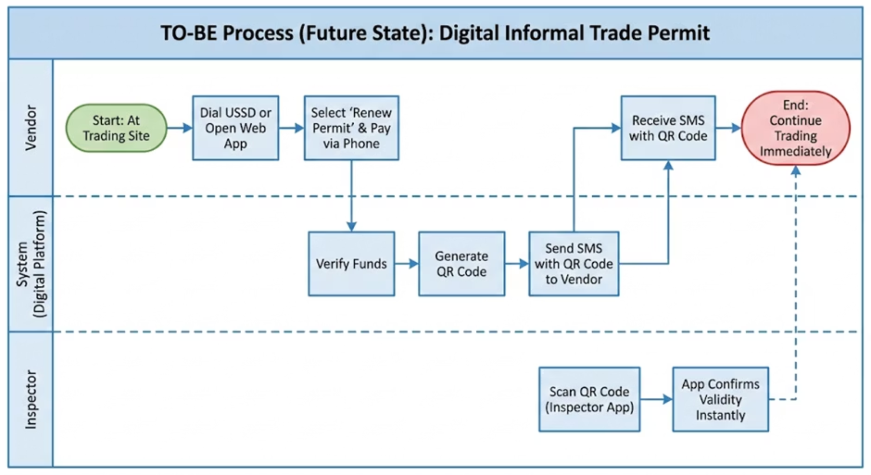
Streamlined Workflow: The "To-Be" State
Transformation Impact
We've fundamentally reimagined the permit process, eliminating unnecessary steps and leveraging digital channels to serve vendors where they are.
From: manual loop requiring physical travel, extended queuing, and cash handling at municipal offices.
To: Few steps digital flow completed in under 5 minutes from the vendor's trading location.
Step 1: Dial USSD code or access web portal
Step 2: Complete payment via mobile money
Step 3: Receive digital permit instantly
Result: Vendors continue trading immediately while inspectors verify status in real-time.

Slide 6
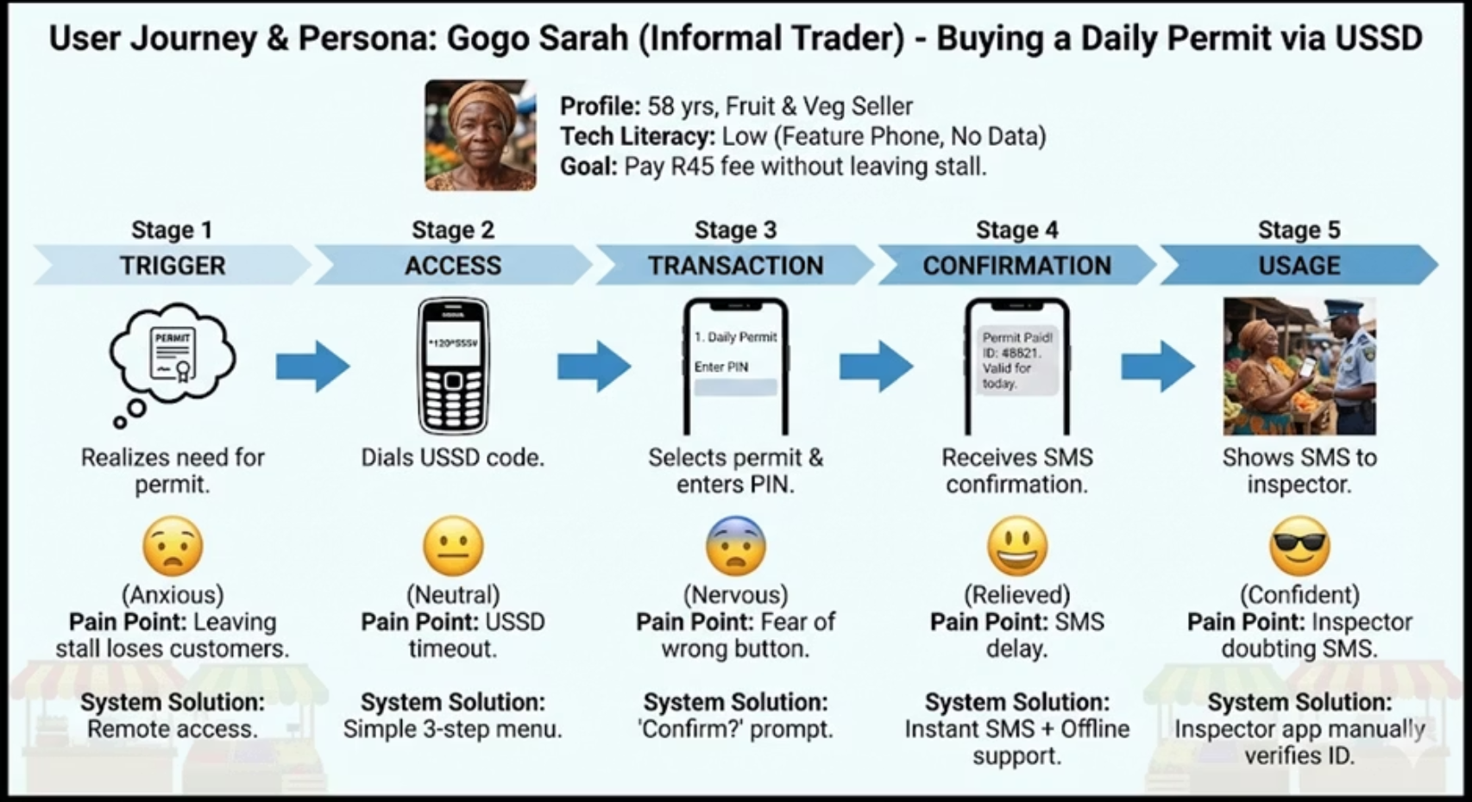
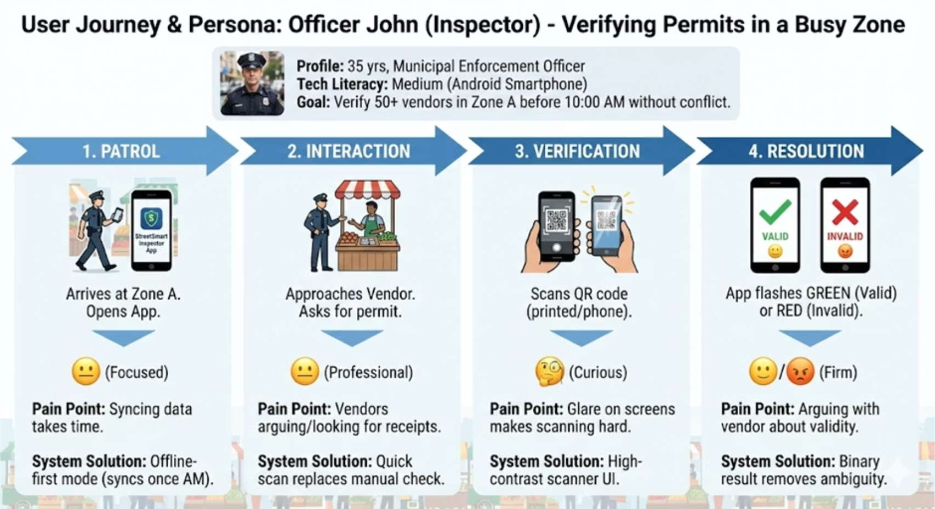
Designed for Real Users
User-centered design principles guided every technical decision. We conducted extensive research with actual vendors and enforcement officers to understand their daily realities and constraints.
Persona A: "Gogo Sarah"
Persona B: "Officer John"
Profile: 58-year-old fruits and vegetable vendor with feature phone, limited digital literacy, cannot leave stall unattended during peak hours.
Profile: Municipal inspector responsible for verifying 50+ vendors daily, faces confrontation when compliance is unclear.
Pain Point: Loses entire morning's revenue when traveling to municipal offices for permit renewal.
Pain Point: Manual record-checking creates delays and disputes. Vendors claim payment even without receipts.
Solution: USSD payment from her stall with SMS confirmation. No internet required, no travel needed, immediate permit issuance.
Solution: Binary "Green/Red" screen results remove ambiguity. QR scan provides instant verification with no room for interpretation or conflict.

Slide 7
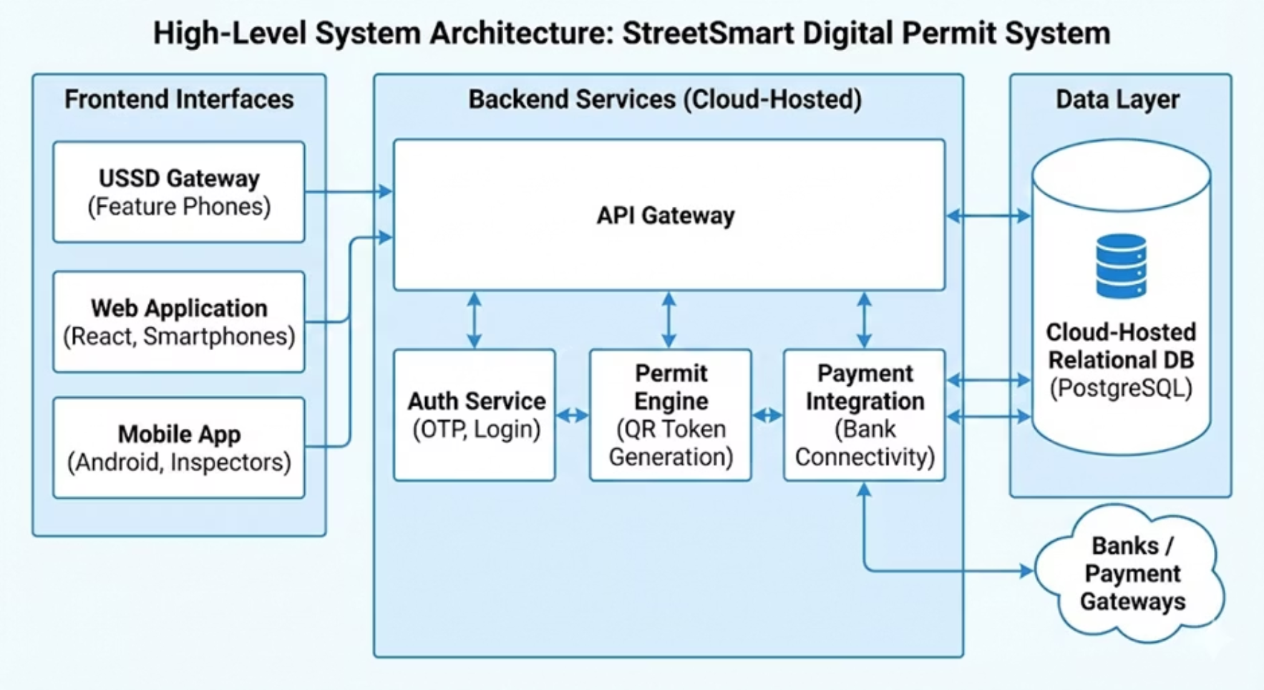
Robust & Scalable Architecture
1
Backend Infrastructure
Built on Node.js and Python microservices architecture, Auth Service, Permit Engine , Payment Integration , deployed on cloud infrastructure (AWS/Azure) for 99.9% uptime and horizontal scalability to support growing user base.
2
Database Layer
PostgreSQL relational database ensures ACID compliance and data integrity. Automated backup systems with point-in-time recovery protect against data loss.
3
Security Framework
Role-Based Access Control (RBAC) with multi-factor authentication. Full POPIA compliance with encrypted data storage and secure transmission protocols (TLS 1.3).
4
Integration Layer
Seamless connections to SMS Gateways (Twilio) for notifications and Payment Processors (PayFast) for secure mobile money transactions with real-time reconciliation.

Slide 8

Validated for Reliability
Comprehensive Quality Assurance
Our multi-phase testing strategy ensures system reliability under real-world conditions. Every component underwent rigorous validation before integration.
01
Unit Testing
Individual component validation with 95% code coverage across all modules.
02
Integration Testing
End-to-end workflow verification including payment gateway and SMS delivery systems.
03
User Acceptance Testing
Real vendors and inspectors validated usability and functionality in simulated environment.
Edge Cases Tested: Offline scanning mode, insufficient funds scenarios, duplicate registration attempts, and network timeout recovery.
Defect Management: All critical defects (including ID validation logic) identified and resolved. Zero high-priority issues remain open.

Slide 9

Ready for Launch
1
Phase 1: Pilot Program
5-day controlled trial in Zone A (Taxi Rank) with 20 selected vendors representing diverse technology literacy levels.
2
Phase 2: Evaluation
Measure success against defined KPIs: 80% vendor adoption rate and 100% financial reconciliation accuracy.
3
Phase 3: Full Rollout
Staged deployment across all trading zones based on pilot learnings and feedback integration.
Deployment Readiness Status
100%
100%
100%
Code Freeze
UAT Sign-Off
Team Training
Development complete and frozen for production deployment
All user acceptance testing approved by stakeholders
Support teams certified and ready for go-live assistance
20
Pilot Vendors
Participants confirmed for initial deployment phase

Slide 10


StreetSmart is Ready for Deployment
Request for Approval
We are seeking formal approval to proceed to Phase 5: Live Deployment. All technical, operational, and training prerequisites have been satisfied.
Expected Impact:
R8,000,000+ annual revenue recovery
3-hour wait time eliminated for vendors
100% digital compliance tracking
Scalable foundation for future expansion
Documentation: Complete technical specifications, user manuals, and training materials available in Version 2.1 for stakeholder review.
Questions?

